Slide 1
Project 601- Drones
Shlomo Assaf and Tomer Bahar

Slide 2
Overview
The drone simulation is implemented using Python programming language and utilizes the PyGame library for the graphical user interface (GUI).
This simulation can create diverse environments. Using open-source GIS data into the simulation. Or generation of random environments, providing flexibility in testing and experimentation.
The simulation incorporates a server component that can efficiently manage and monitor multiple drones simultaneously.
In this simulation we can control a drone's movement by giving it a velocity vector, the simulation support both getting commands from the user or a RL controller that provide this vector and try to learn the best way to get to the destination.

Slide 3
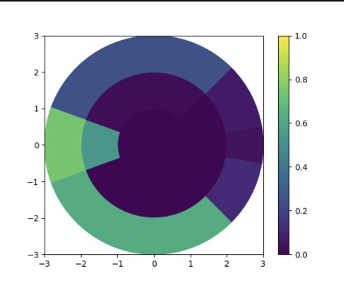
The Drone
The Radar
Is a 2D(3D) radar that divides its view into regions and scopes, this way it has less states to calculate and the learning can be more effective
Radar
GPS
Battery
Motion Control
Drone

Slide 4
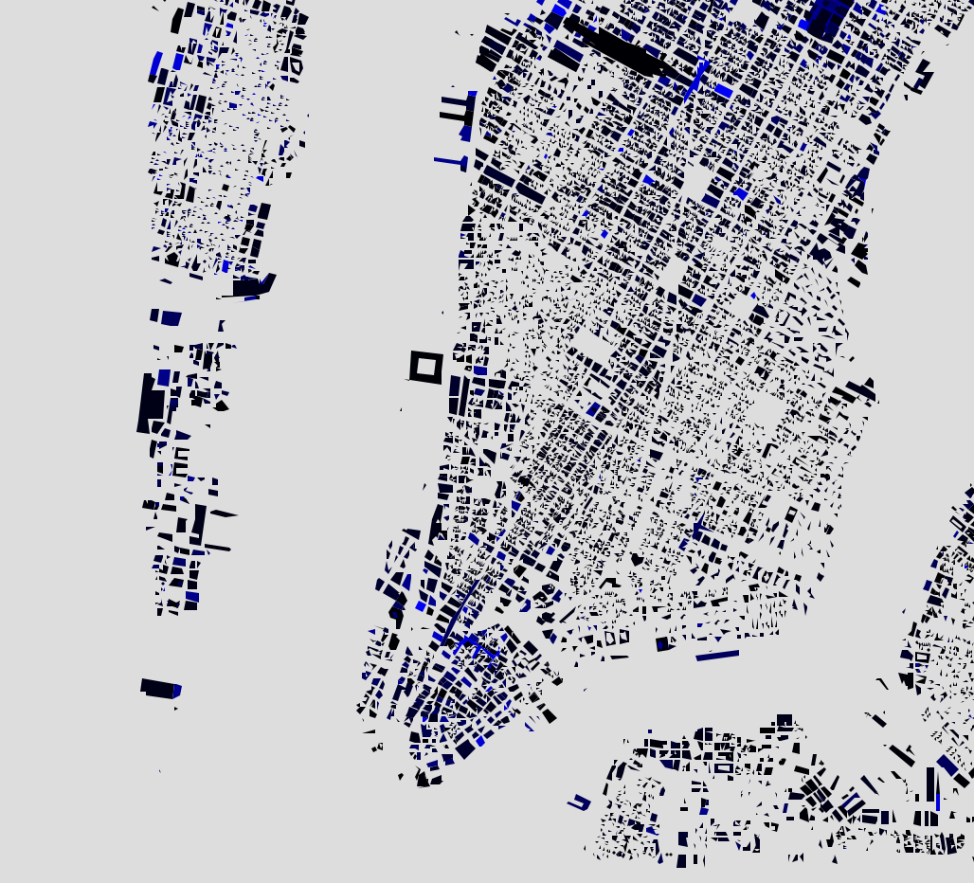
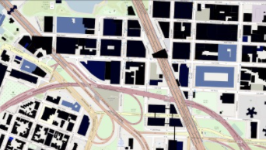
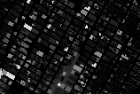
The Map
To make the simulation more realistic we put an effort into creating a tool that generates 1 pixel per meter map.
First we extract geojson building data from an open street map.
Using the folium library we managed to draw the building on a street map (similar to Google Maps)
Then using scraping we were able to make the final map. (stitching small images downloaded separately).

Slide 5
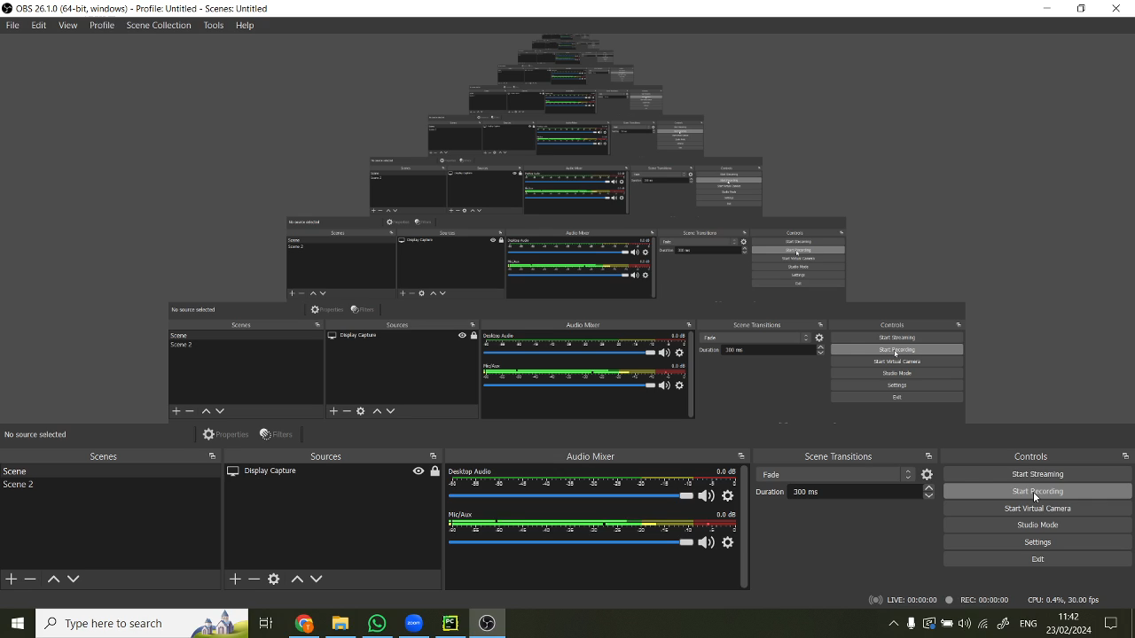
The Map – tutorial for geojson

Slide 6
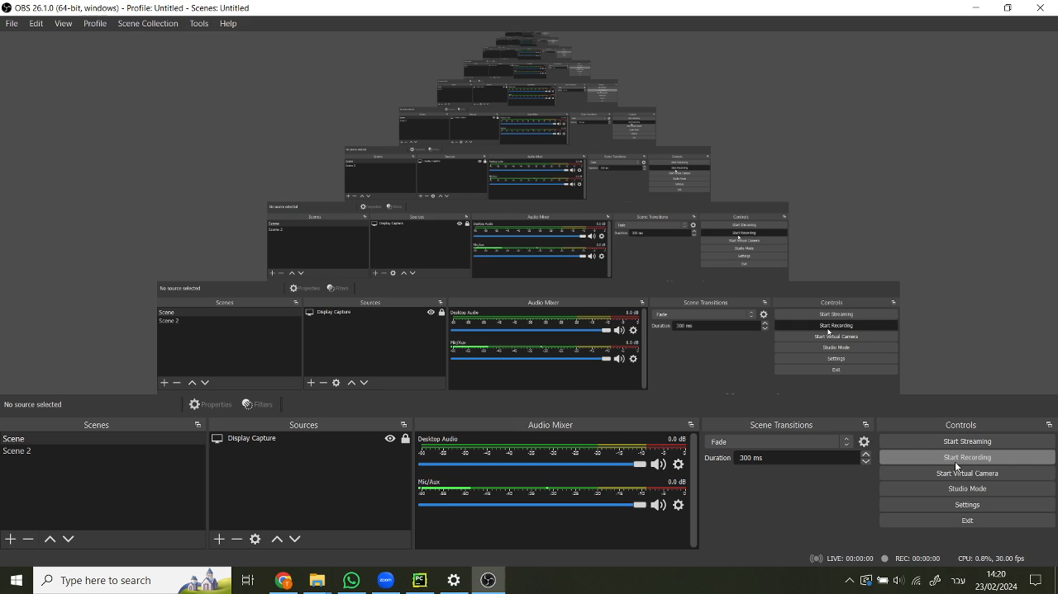
The Map – tutorial for map generate

Slide 7
The Graphs – Neo4j
A major challenge encountered during the calculation of drone routes was the complexity of the 3D map, which proved too intricate to compute within a reasonable timeframe.
To address this issue, we implemented a graph-based approach to explore all possible drone movement options. While the calculation process may take some time (depending on the user's computer), the resulting graph is stored on a server for future reuse, particularly when operating within the same map.
For this purpose, we employed a service named neo4j for the graph server.
Neo4j is a graph database management system that excels in storing and querying graph data structures, offering efficient traversal and manipulation capabilities essential for our drone route optimization tasks.

Slide 8
UML
Environment
Drone
GPS
Pre-game map generator
RL
Motion Controller
Power management
Radar
PyGame Handler
Environment info server
Drone server
Graph server

Slide 9
Reinforcement learning Deep Q-Learning
Implemented DQN-based controller for single drone
48-hour training period yielded minimal progress
DQN framework unsuitable due to extensive action vector
Drone proficient in avoiding collisions, but unable to reach destination
Conclusion: DQN inadequate for nuanced problem requirements

Slide 10
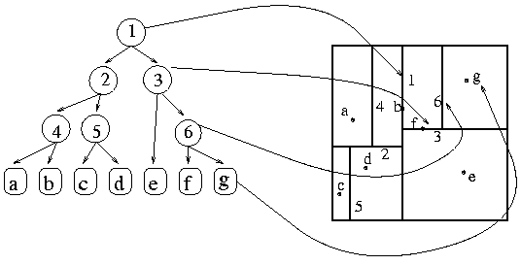
Reinforcement learning KD-Tree Q-Learning
Utilized KD-Q-Learning for agent training
Some improvement observed in the learning process
Drone adept at avoiding buildings but failed to reach the destination or avoid other drones
Primary reason: inability to reach the intended destination
Challenge: classification of actions for a given state
KD-tree similarity treatment resulted in difficulty distinguishing obstacle encounters
Consequently, the agent struggled with accurate actions, especially navigation
KD-Q-Learning is effective in obstacle avoidance but inadequate for precise destination navigation

Slide 11
conclusion
We created a centralized controller that manages all drones in the simulation
The preflight phase involves map transformation into a 3D graph this stage takes some time for a new map.
Controller calculates the shortest path for each drone from the 3D graph
Supervisory role during drone flights, ensuring adherence to designated paths
Tasks:
Implement collision detection algorithms for real-time avoidance.
Enable the controller to guide drones in route deviation and collision avoidance.
Train the controller to allocate tasks based on drone capabilities and task requirements.

